Slide 1
失业
© 2015 Cengage Learning. All Rights Reserved. May not be copied, scanned, or duplicated, in whole or in part, except for use as permitted in a license distributed with a certain product or service or otherwise on a password-protected website for classroom use.
1

Slide 2
失业的确认
© 2015 Cengage Learning. All Rights Reserved. May not be copied, scanned, or duplicated, in whole or in part, except for use as permitted in a license distributed with a certain product or service or otherwise on a password-protected website for classroom use.
2
就业者
这类工作的人包括
得到报酬的人
在他们的企业里
在家族里拿不到工资的人
全职工作和部分时间工作的人
暂时不工作者
度假、生病、天气恶劣

Slide 3
失业的确认
© 2015 Cengage Learning. All Rights Reserved. May not be copied, scanned, or duplicated, in whole or in part, except for use as permitted in a license distributed with a certain product or service or otherwise on a password-protected website for classroom use.
3
失业者
这些不工作的人包括
能够工作
努力在四周之内找到工作的人
这些人等待重新被召回
被解雇

Slide 4
失业的确认
© 2015 Cengage Learning. All Rights Reserved. May not be copied, scanned, or duplicated, in whole or in part, except for use as permitted in a license distributed with a certain product or service or otherwise on a password-protected website for classroom use.
4
非劳动力
既不属于失业者也不属于就业者
全日制学生
家务劳动者
退休人员

Slide 5
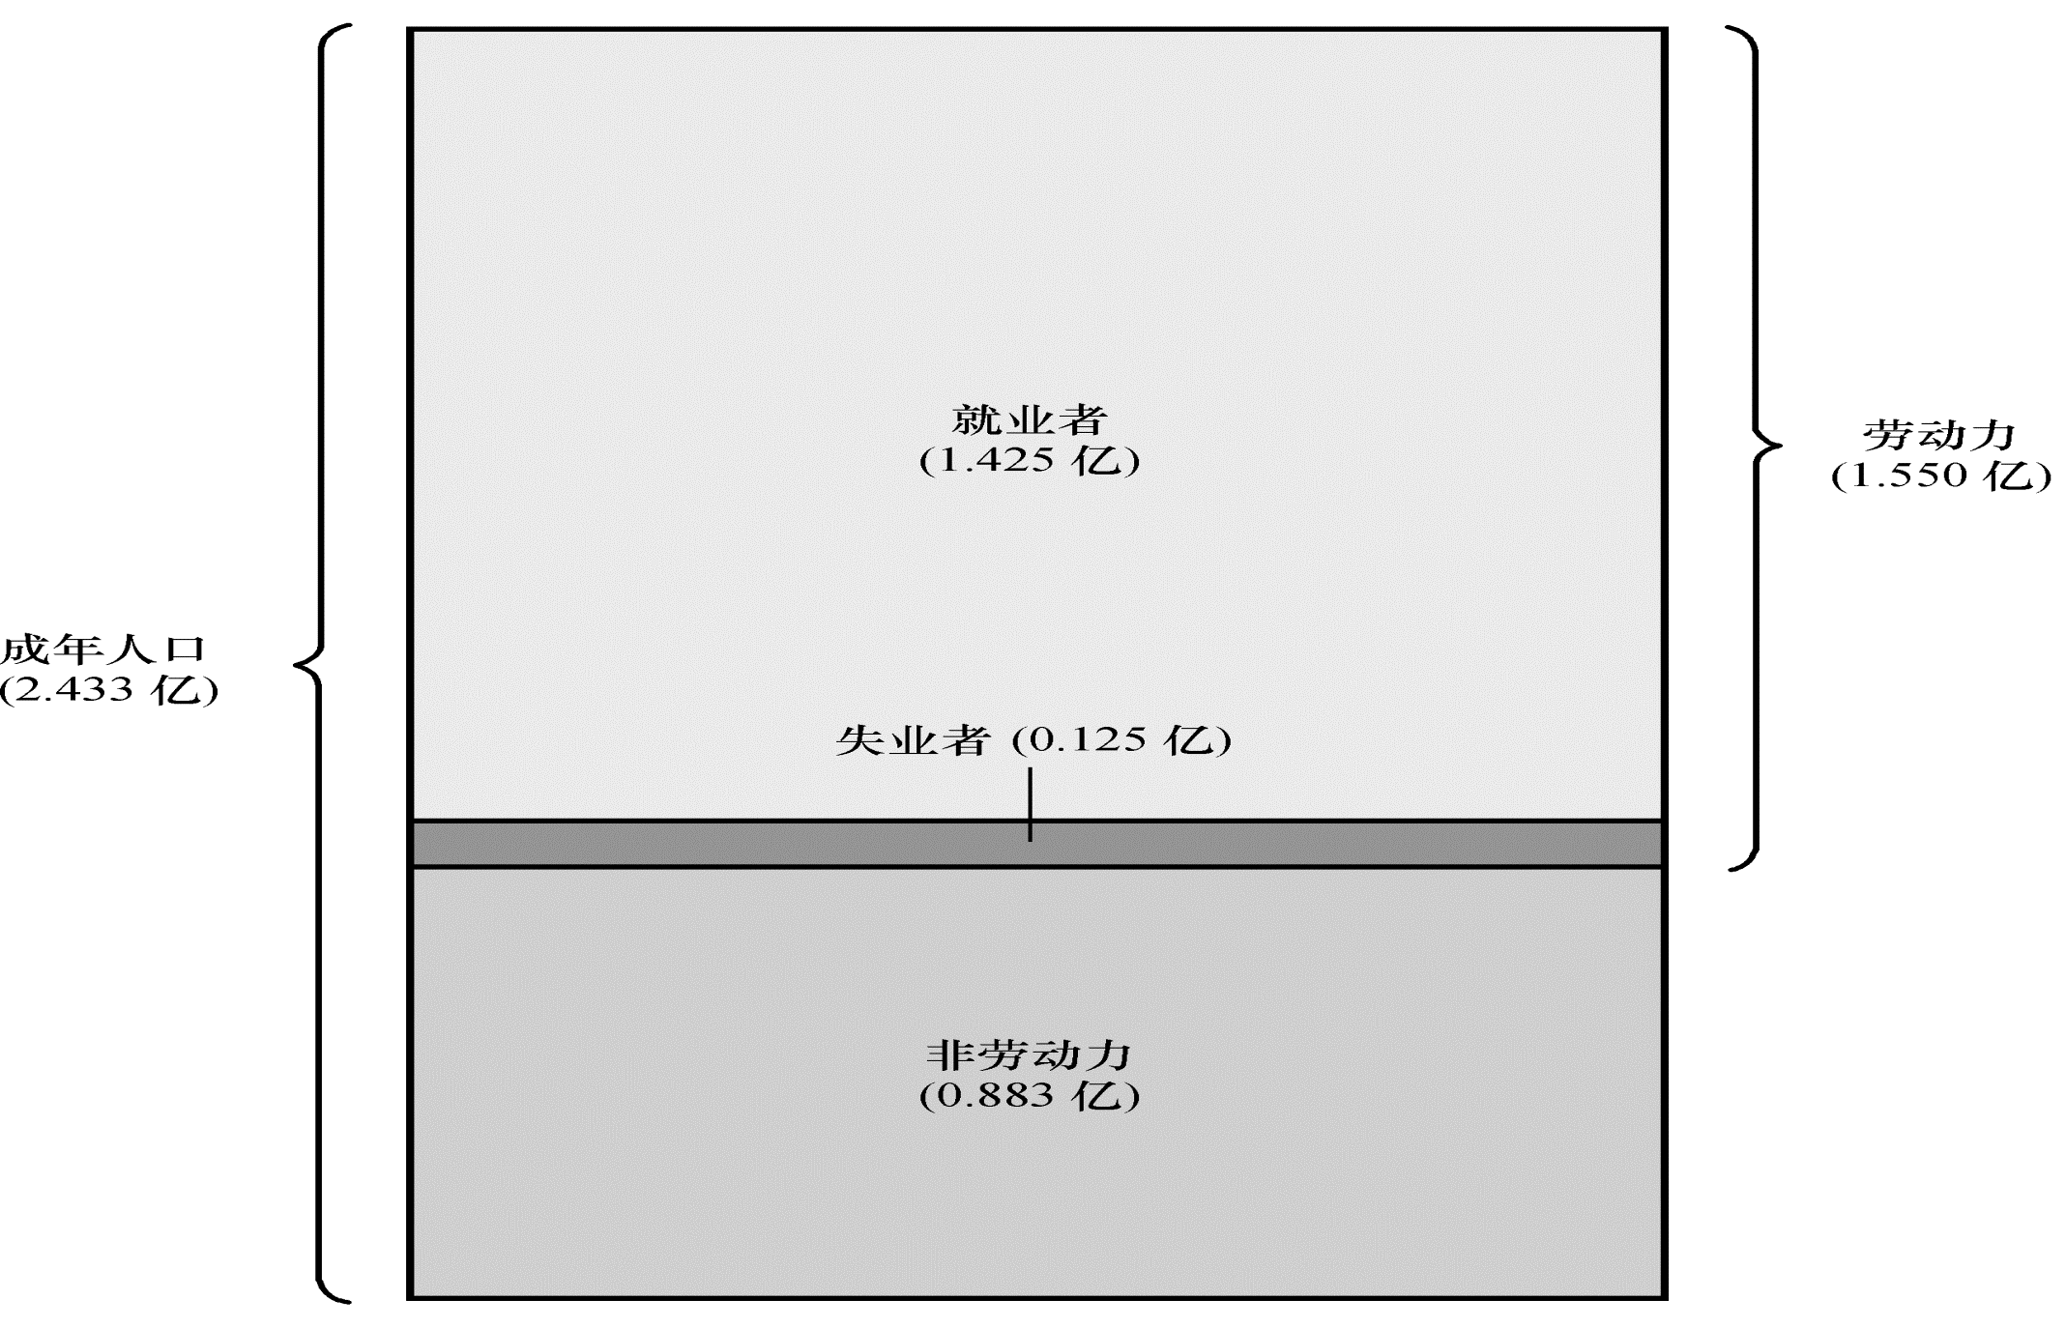
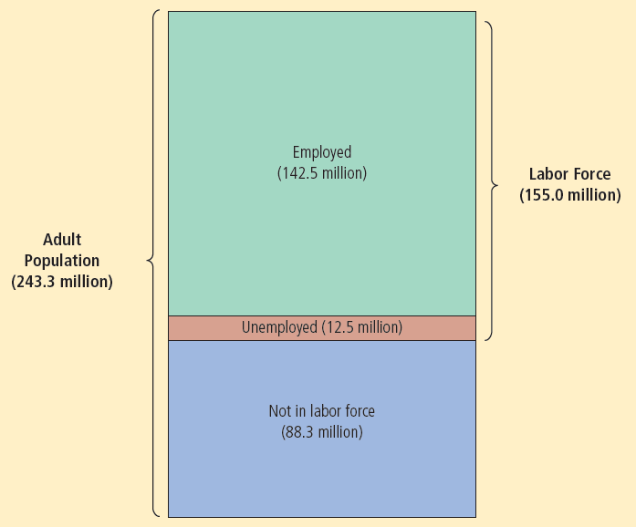

图 1
2012年人口的分类
劳工统计局把人口分为三类：就业者、失业者和非劳动力。
© 2015 Cengage Learning. All Rights Reserved. May not be copied, scanned, or duplicated, in whole or in part, except for use as permitted in a license distributed with a certain product or service or otherwise on a password-protected website for classroom use.
5

Slide 6
失业的确认
© 2015 Cengage Learning. All Rights Reserved. May not be copied, scanned, or duplicated, in whole or in part, except for use as permitted in a license distributed with a certain product or service or otherwise on a password-protected website for classroom use.
6
劳动力
包括失业者和劳动力的工人总数
= 就业人数 + 失业人数
失业率
劳动力中失业人口的比例

Slide 7
失业的确认
劳动力参工率
劳动力在成年人口中的比例
人口中参与劳动力市场的部分
就业-人口比率= (就业人数÷工作年龄人口)*100%
© 2015 Cengage Learning. All Rights Reserved. May not be copied, scanned, or duplicated, in whole or in part, except for use as permitted in a license distributed with a certain product or service or otherwise on a password-protected website for classroom use.
7

Slide 8
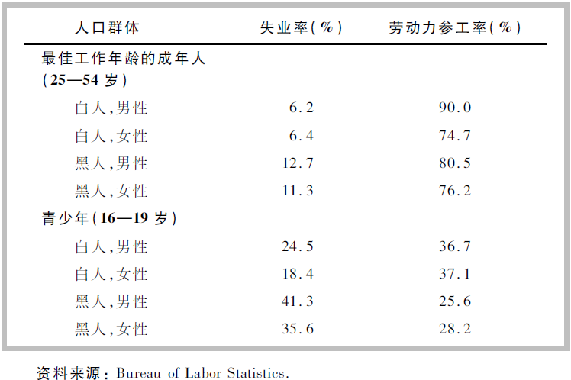
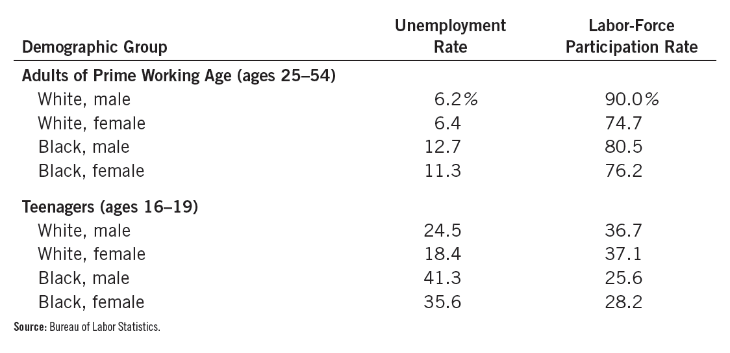
表 1
不同人口群体中的劳动市场经历
该表显示了美国人口中不同群体的失业率与劳动力参工率。
© 2015 Cengage Learning. All Rights Reserved. May not be copied, scanned, or duplicated, in whole or in part, except for use as permitted in a license distributed with a certain product or service or otherwise on a password-protected website for classroom use.
8

Slide 9
失业的确人
© 2015 Cengage Learning. All Rights Reserved. May not be copied, scanned, or duplicated, in whole or in part, except for use as permitted in a license distributed with a certain product or service or otherwise on a password-protected website for classroom use.
9
劳动力市场经历
妇女的主要工作时间(25 到 54岁)
劳动力参工率比男性低
一旦加入劳动大军
男性和女性-有着类似的失业率

Slide 10
失业的确人
© 2015 Cengage Learning. All Rights Reserved. May not be copied, scanned, or duplicated, in whole or in part, except for use as permitted in a license distributed with a certain product or service or otherwise on a password-protected website for classroom use.
10
劳动市场经历
黑人的主要工作时间
和相似年龄的白人有着一样的劳动力参工率
更高的失业率
青年
更低的劳动力参与率
比年长的工人有着更高的失业率

Slide 11
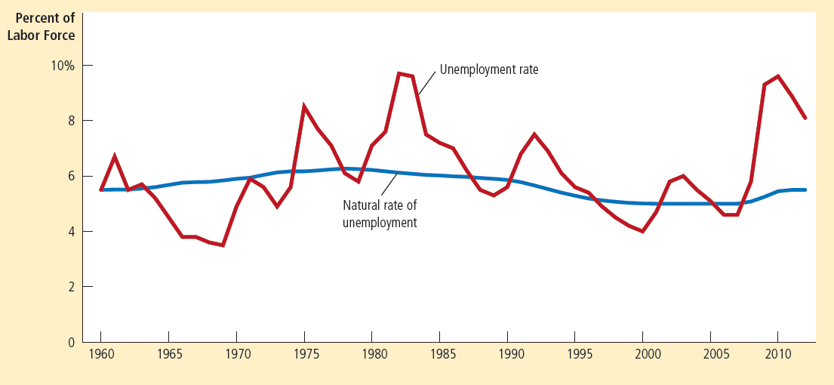

图 2
1960年以来的失业率
该图用美国失业率的年度数据来说明没有工作的劳动力的百分比。自然失业率是正常的失业水平，失业率围绕他上下波动。
© 2015 Cengage Learning. All Rights Reserved. May not be copied, scanned, or duplicated, in whole or in part, except for use as permitted in a license distributed with a certain product or service or otherwise on a password-protected website for classroom use.
11

Slide 12
失业的确认
自然失业率
失业率围绕它上下波动的正常失业率
2012: 5.5% (远远低于实际的失业率 8.1%)
周期性失业
失业率对自然失业率的背离
© 2015 Cengage Learning. All Rights Reserved. May not be copied, scanned, or duplicated, in whole or in part, except for use as permitted in a license distributed with a certain product or service or otherwise on a password-protected website for classroom use.
12

Slide 13
美国经济中的男性和女性的劳动力参与率
女性在美国社会中的作用
一个世纪以来发生了巨大的变化
新技术
减少了完成日常家务劳动所需的时间
有效的生育控制
减少了普通家庭儿童的数量
变化的政治与社会态度
© 2015 Cengage Learning. All Rights Reserved. May not be copied, scanned, or duplicated, in whole or in part, except for use as permitted in a license distributed with a certain product or service or otherwise on a password-protected website for classroom use.
13

Slide 14
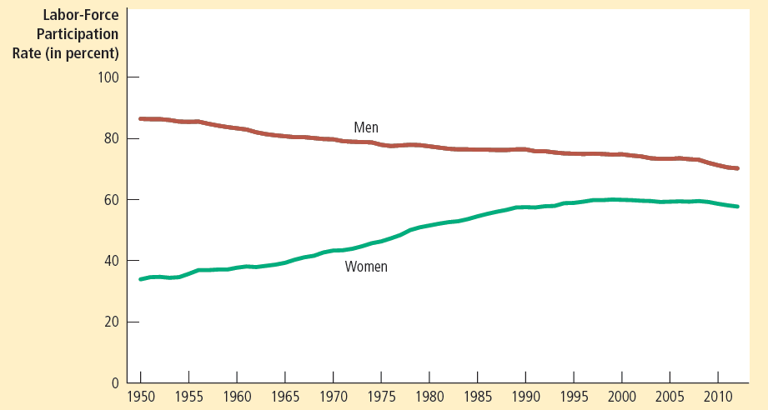
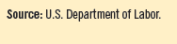
图 3
1950年以来的男性与女性的劳动力参工率
该图显示了劳动力成员中成年男性与女性的各自比率。它表明在过去的几十年间，更多的女性进入了劳动力队伍，从而一些男性则离开了劳动力队伍。
© 2015 Cengage Learning. All Rights Reserved. May not be copied, scanned, or duplicated, in whole or in part, except for use as permitted in a license distributed with a certain product or service or otherwise on a password-protected website for classroom use.
14

Slide 15
美国经济中的男性和女性的劳动力参与率
男性的劳动力参与率在下降
年轻男性在学校的时间更长
年长的工人退休的更早和活得更长
更多的女性被雇佣
更多的父亲待在家里养小孩
不算在劳动力的
全职学生、退休者
留在家里照顾孩子的父亲
© 2015 Cengage Learning. All Rights Reserved. May not be copied, scanned, or duplicated, in whole or in part, except for use as permitted in a license distributed with a certain product or service or otherwise on a password-protected website for classroom use.
15

Slide 16
失业的确认
© 2015 Cengage Learning. All Rights Reserved. May not be copied, scanned, or duplicated, in whole or in part, except for use as permitted in a license distributed with a certain product or service or otherwise on a password-protected website for classroom use.
16
官方失业率
有用的
不完美的度量指标
进入和退出劳动力
普遍的

Slide 17
失业的确认
© 2015 Cengage Learning. All Rights Reserved. May not be copied, scanned, or duplicated, in whole or in part, except for use as permitted in a license distributed with a certain product or service or otherwise on a password-protected website for classroom use.
17
失业
并不是所有的失业者到最后都找到工作
超过一半的失业者在失业时离开了劳动力大军
这些报告失业的人
可能没有努力寻找工作
想获取政府帮助
具有灰色收入的人

Slide 18
失业的确认
© 2015 Cengage Learning. All Rights Reserved. May not be copied, scanned, or duplicated, in whole or in part, except for use as permitted in a license distributed with a certain product or service or otherwise on a password-protected website for classroom use.
18
退出劳动力市场的人
可能想工作
失去信心的工人
失去信心的工人
想工作
已经放弃找工作

Slide 19
失业的确认
© 2015 Cengage Learning. All Rights Reserved. May not be copied, scanned, or duplicated, in whole or in part, except for use as permitted in a license distributed with a certain product or service or otherwise on a password-protected website for classroom use.
19
失业者没有工作的时间有多长
大部分失业是短期的
大部分失业在长期是可以观察到的
大部分失业的人
很快会找到工作

Slide 20
失业的确认
失业者没有工作的时间有多长?
大部分失业是短期的，而在任何一个既定时间所观察到的大多数失业又是长期的
大部分经济中的失业问题
归因于小部分失业者长时间没有工作
© 2015 Cengage Learning. All Rights Reserved. May not be copied, scanned, or duplicated, in whole or in part, except for use as permitted in a license distributed with a certain product or service or otherwise on a password-protected website for classroom use.
20

Slide 21
失业的确认
© 2015 Cengage Learning. All Rights Reserved. May not be copied, scanned, or duplicated, in whole or in part, except for use as permitted in a license distributed with a certain product or service or otherwise on a password-protected website for classroom use.
21
失业率
从没有下降到零
在自然失业率上下波动
摩擦性失业
由于工人寻找最适合自己嗜好和技能的工作需要时间
解释较短的失业

Slide 22
失业的确认
© 2015 Cengage Learning. All Rights Reserved. May not be copied, scanned, or duplicated, in whole or in part, except for use as permitted in a license distributed with a certain product or service or otherwise on a password-protected website for classroom use.
22
结构性失业
因为一些劳动市场可提供的工作岗位数量
不足以为每位想工作的人提供工作
解释长期失业
因为工资在均衡工资之上
最低工资法, 工会和效率工资

Slide 23
失业的确认
周期性失业
——伴随着经济周期而波动的失业。在经济衰退时，周期性失业会增加；在经济扩张时，周期性失业减少。
——一个工人在经济衰退时被辞退，几个月后在经济开始扩张时又被重新召回，就经历了周期性失业。
治理：国家积极干预经济，刺激有效需求，实现充分就业
- 如：刺激私人投资、促进国家投资

Slide 24
失业与充分就业
自然失业率
是达到充分就业时的失业率，它等于摩擦性失业率与结构性失业率之和。
充分就业时的实际GDP称为潜在GDP。

Slide 25
比较不同的失业类型
哪一种失业可以消除？
--摩擦性失业和结构性失业可以通过加强工作信息传递和技术培训等措施减少，却不能根本消除
--周期性失业可以通过经济手段和政策来消除

Slide 26
寻找工作
寻找工作
在工人的嗜好与技能既定时工人寻找适当工作的过程
工人的嗜好与技能不同
工作的性质不同
寻找工作的人和职位空缺的信息扩散的缓慢
© 2015 Cengage Learning. All Rights Reserved. May not be copied, scanned, or duplicated, in whole or in part, except for use as permitted in a license distributed with a certain product or service or otherwise on a password-protected website for classroom use.
26

Slide 27
寻找工作
一些摩擦失业是不可避免的
不同企业间劳动需求是变动的
各行业和地区之间的需求是变化的 (部门转移)
经济总是变化的
一些企业创作了工作岗位
一些企业中工作岗位消失了
© 2015 Cengage Learning. All Rights Reserved. May not be copied, scanned, or duplicated, in whole or in part, except for use as permitted in a license distributed with a certain product or service or otherwise on a password-protected website for classroom use.
27

Slide 28
公共政策和寻找工作
减少失业者寻找工作的时间
使自然失业率减少
政府项目– 促进寻找工作
政府管理的就业机构
公共培训计划
© 2015 Cengage Learning. All Rights Reserved. May not be copied, scanned, or duplicated, in whole or in part, except for use as permitted in a license distributed with a certain product or service or otherwise on a password-protected website for classroom use.
28

Slide 29
公共政策和寻找工作
失业保险
政府项目
部分保障工人收入
当他们失业时
增加了摩擦性失业
无意中
仅向以前雇主不再需要其技能而被解雇的失业者支付补助
© 2015 Cengage Learning. All Rights Reserved. May not be copied, scanned, or duplicated, in whole or in part, except for use as permitted in a license distributed with a certain product or service or otherwise on a password-protected website for classroom use.
29

Slide 30
公共政策和寻找工作
失业保险
26周得到工资的50%
减轻了失业者的痛苦
增加了失业的数量
失业者在找到工作时停止获得资助
失业
降低了寻找工作的努力程度
倾向于拒绝没有吸引力的工作
倾向于寻找合适的工作
© 2015 Cengage Learning. All Rights Reserved. May not be copied, scanned, or duplicated, in whole or in part, except for use as permitted in a license distributed with a certain product or service or otherwise on a password-protected website for classroom use.
30

Slide 31
最低工资法
© 2015 Cengage Learning. All Rights Reserved. May not be copied, scanned, or duplicated, in whole or in part, except for use as permitted in a license distributed with a certain product or service or otherwise on a password-protected website for classroom use.
31
结构性失业
工作数量不足
最低工资法
可能创造失业
强制工资位于均衡工资之上
更高的劳动力供给数量
更低的劳动力需求数量
劳动力过剩 = 失业

Slide 32
图 4
工资高于均衡水平引起的失业
工资
劳动过剩 = 失业量
_{劳动供给}
最低工资
W_{E}
_{劳动需求}
0
L_{D}
L_{E}
L_{S}
劳动量
在这个劳动力市场上，使供给与需求平衡的工资W_{E}。在这一均衡工资之上，劳动力的供给量与需求量等于L_{E}。与此相比，如果最低工资法使工资被迫高于均衡水平，劳动供给量增加到L_{S}，而劳动量下降到L_{D}，就会引起过剩的劳动L_{S}-L_{D}，它表示失业。
© 2015 Cengage Learning. All Rights Reserved. May not be copied, scanned, or duplicated, in whole or in part, except for use as permitted in a license distributed with a certain product or service or otherwise on a password-protected website for classroom use.
32

Slide 33
最低工资法
© 2015 Cengage Learning. All Rights Reserved. May not be copied, scanned, or duplicated, in whole or in part, except for use as permitted in a license distributed with a certain product or service or otherwise on a password-protected website for classroom use.
33
工资可能保持在均衡工资之上
最低工资法
工会
效率工资
如果工资保持在均衡工资之上
结果: 失业

Slide 34
工会和集体谈判
© 2015 Cengage Learning. All Rights Reserved. May not be copied, scanned, or duplicated, in whole or in part, except for use as permitted in a license distributed with a certain product or service or otherwise on a password-protected website for classroom use.
34
工会
工人协会
与雇主谈判
工资, 津贴和工作条件
11% 的美国工人
一种卡特尔

Slide 35
工会和集体谈判
© 2015 Cengage Learning. All Rights Reserved. May not be copied, scanned, or duplicated, in whole or in part, except for use as permitted in a license distributed with a certain product or service or otherwise on a password-protected website for classroom use.
35
集体谈判
工会和企业就就业条件达成一致过程
罢工
工会组织工人从企业撤出
减少生产、销售和利润
工会工人
比没有加入工会的工人的工资多10%-20%

Slide 36
工会和集体谈判
© 2015 Cengage Learning. All Rights Reserved. May not be copied, scanned, or duplicated, in whole or in part, except for use as permitted in a license distributed with a certain product or service or otherwise on a password-protected website for classroom use.
36
工会把工资提高到均衡工资之上
更高的劳动的供给
更低的劳动的需求
失业
变好的: 就业工人 (局内人)
变坏的: 失业者(局外人)
可能一直失业；或等待时机成为局内人
在没有工会的企业找到工作

Slide 37
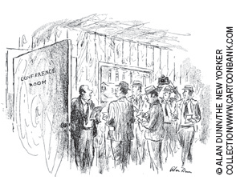
工会和集体谈判
工会把工资提高到均衡工资之上
降低了没有工会组织的工资水平和提高其劳动需求
工会中的工人
获得集体谈判的收益
工会外的工人
承受一些成本
“先生们，除了管理者想利润最大化和工会想要更多的钱以外，没有什么阻止最后一致。”
© 2015 Cengage Learning. All Rights Reserved. May not be copied, scanned, or duplicated, in whole or in part, except for use as permitted in a license distributed with a certain product or service or otherwise on a password-protected website for classroom use.
37

Slide 38
工会和集体谈判
© 2015 Cengage Learning. All Rights Reserved. May not be copied, scanned, or duplicated, in whole or in part, except for use as permitted in a license distributed with a certain product or service or otherwise on a password-protected website for classroom use.
38
工会对经济是好是坏?
批评者
工会 - 一种卡特尔
劳动配置
无效率 - 工会的高工资使有工会组织的企业
就业降低到有效率的竞争水平之上
不公平 - 一些工人的获益是以另一些工人的
损失为代价的

Slide 39
工会和集体谈判
© 2015 Cengage Learning. All Rights Reserved. May not be copied, scanned, or duplicated, in whole or in part, except for use as permitted in a license distributed with a certain product or service or otherwise on a password-protected website for classroom use.
39
工会对经济是好是坏?
支持者
工会 - 是与雇佣工人的企业的市场势力抗衡所必需的
如果没有工会, 企业会支付更低的工资和提供更差的工作的条件
工会- 帮助企业有效对工人的利益做出反应
使企业保持一只乐观和富有生产效率的劳动力队伍

Slide 40
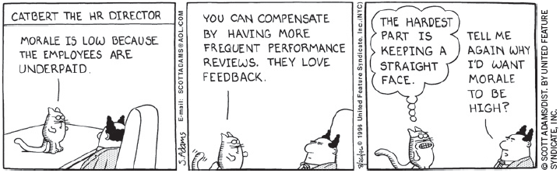
效率工资理论
© 2015 Cengage Learning. All Rights Reserved. May not be copied, scanned, or duplicated, in whole or in part, except for use as permitted in a license distributed with a certain product or service or otherwise on a password-protected website for classroom use.
40
效率工资
企业为了提高工人的生产率而支付的高于均衡水平的工资
工人健康; 工人流动率
工人素质; 工人努力程度

Slide 41
效率工资理论
© 2015 Cengage Learning. All Rights Reserved. May not be copied, scanned, or duplicated, in whole or in part, except for use as permitted in a license distributed with a certain product or service or otherwise on a password-protected website for classroom use.
41
工人健康
工资高的工人
饮食的营养更丰富
更健康和更高的生产率
工人流动率
企业可以消减工人流动率
通过支付更高的工资

Slide 42
效率工资理论
© 2015 Cengage Learning. All Rights Reserved. May not be copied, scanned, or duplicated, in whole or in part, except for use as permitted in a license distributed with a certain product or service or otherwise on a password-protected website for classroom use.
42
工人素质
企业 – 支付更高的工资
吸引更好的申请者
提高了工人素质
工人努力程度
高工资– 使工人更热切的保持他的工作
给予工人付出最大努力的激励

Slide 43
亨利 福特及其极为慷慨的每天5美元工资
亨利 福特是福特汽车的创始人
引进了现代生产技术
用装配线来生产汽车
不熟练的工人被教会完成不断重复简单工作
产出: T型福特车
© 2015 Cengage Learning. All Rights Reserved. May not be copied, scanned, or duplicated, in whole or in part, except for use as permitted in a license distributed with a certain product or service or otherwise on a password-protected website for classroom use.
43

Slide 44
亨利 福特及其极为慷慨的每天5美元工资
1914, 福特: 5美元每天
一般工资的两倍
求职者排成长队
想工作的工人数量> 福特需求的数量
福特的高工资政策: 效率工资
© 2015 Cengage Learning. All Rights Reserved. May not be copied, scanned, or duplicated, in whole or in part, except for use as permitted in a license distributed with a certain product or service or otherwise on a password-protected website for classroom use.
44

Slide 45
亨利 福特及其极为慷慨的每天5美元工资
福特高工资政策
流动率下降
缺勤率下降
生产率上升
工人 – 更有效率
福特的生产成本下降了
公司更有利润了
© 2015 Cengage Learning. All Rights Reserved. May not be copied, scanned, or duplicated, in whole or in part, except for use as permitted in a license distributed with a certain product or service or otherwise on a password-protected website for classroom use.
45

Slide 46
亨利 福特及其极为慷慨的每天5美元工资
福特的效率工资
工人更努力
与装配线的使用是密切相关的
装配线- 使工人联系更紧密
© 2015 Cengage Learning. All Rights Reserved. May not be copied, scanned, or duplicated, in whole or in part, except for use as permitted in a license distributed with a certain product or service or otherwise on a password-protected website for classroom use.
46

